Slide 1



AES
Add-on processor for RISC-V
Students: David Dan
Dolev Vaknin
Supervisor: Eric Herbelin

Slide 2
Abstract
In our days, where we use sensors and processors anywhere and anytime, it’s getting
very hard to keep our data safe.
There are a lot of chances to steal the information between collecting the raw data by a sensor, and encryption of that data by our processor.
The goal of this project is to design and implement an AES encryption (or any other safe encryption method) inside RISC-V processor, which can be positioned adjacent to a sensor.
In this project we are using RI5CY core embedded in Pulpenix microcontroller.
Introduction
AES algorithm
Workflow
Simulations
Results
Methodology
Conclusions

Slide 3
Background
RISC-V
Open ISA
Founded by University of Berkeley, California.
Adopted by many in both academy and industry.
PULP
Parallel Ultra Low Power open-source computing platform
A collaboration of ETH Zurich and University of Bologna.
PULPino
Based on PULP platform.
Uses RI5CY core.
PULPeniX
Developed in Bar Ilan, Enics lab.
A HW and SW development and simulation environment.
AES
Advanced Encryption Standard - specification for the encryption of electronic data.
Based on a design principle known as a substitution–permutation network.

Slide 4
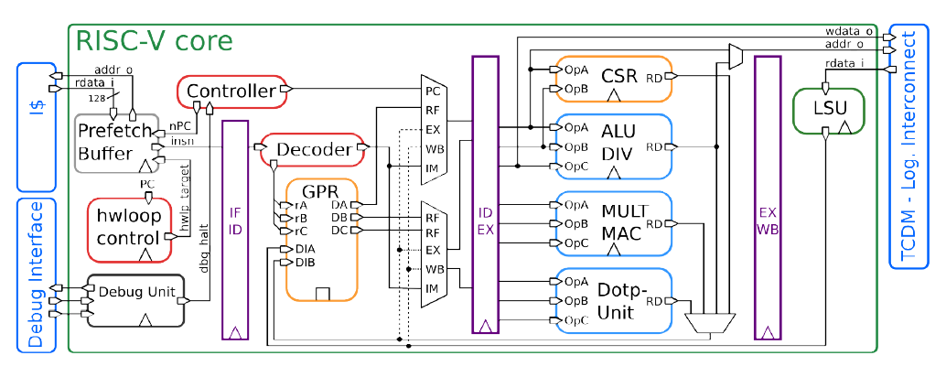
RI5CY Core

Slide 5
Goals
Knowing RISC-V PULPENIX infrastructure
Based on Michael and Avi project.
Integrating AES in RISC-V environment
AES accelerator and designated new commands (While maintaining backward compatibility).
Demonstrate advantages in terms of performance
We expect to increase in power, area (decrease in performance).

Slide 6
Possible solutions – pros and cons
 | Encryption from buffer | Encryption on-the-fly | Encryption command
Pros | Relatively secure Relatively Easy to implement | Easy to implement Encryption in early stages Economical | Can store one encrypted register
Cons | Need to encrypt 4 registers (128-bit) Requires a lot more area. | Not secure (not AES) | Not very secure Hard to implement Slow down the processor

Slide 7
AES algorithm
AES encryption is done in several rounds (10 rounds for 128 bit key), and each one of the rounds is consist of several processing steps.
Plain-Text
Key
Round Key (0)
SubBytes
ShiftRows
…
MixColumn
…
Key Expansion Unit
Round Key (9)
SubBytes
ShiftRows
Round Key (10)
Cipher text
Introduction
AES algorithm
Workflow
Simulations
Results
Methodology
Conclusions

Slide 8
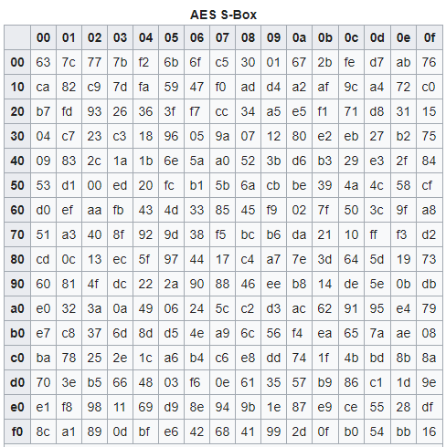
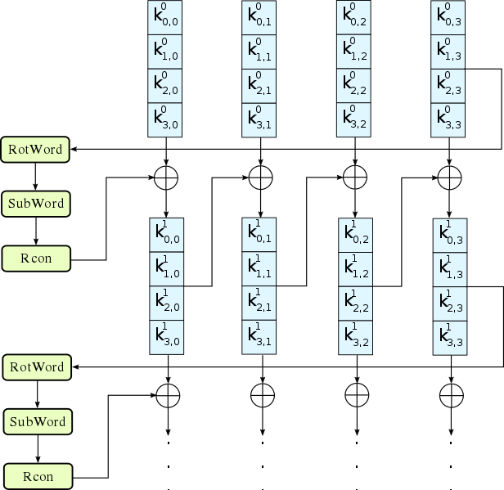
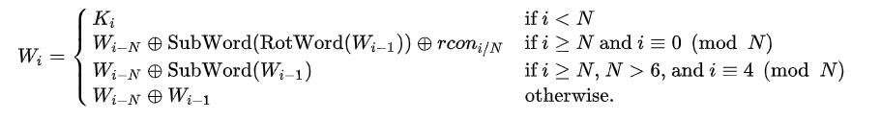
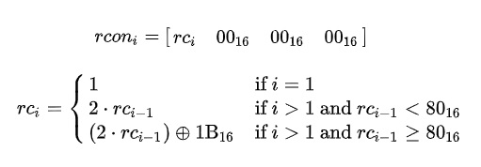
KeyExpansion
Expanding the given key with 128 bits to 1408 bits using Rijndael's key schedule.
RotWord
SubWord
Rcon

Slide 9
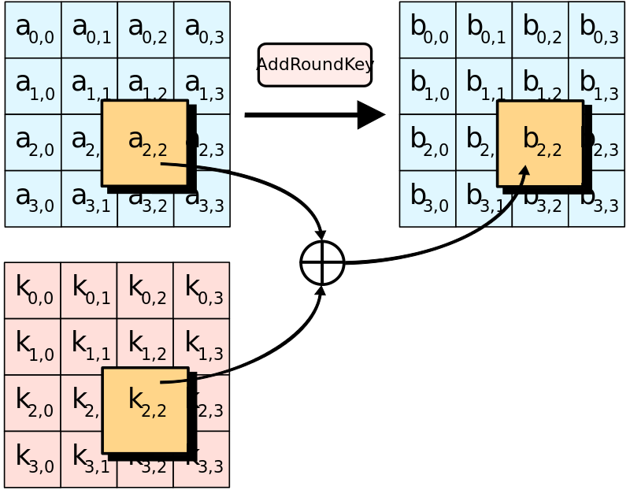
AddRoundKey
Each byte of the state is combined with a byte of the round key using bitwise xor. (twice in the first round - in the beginning and in the end of the round)

Slide 10
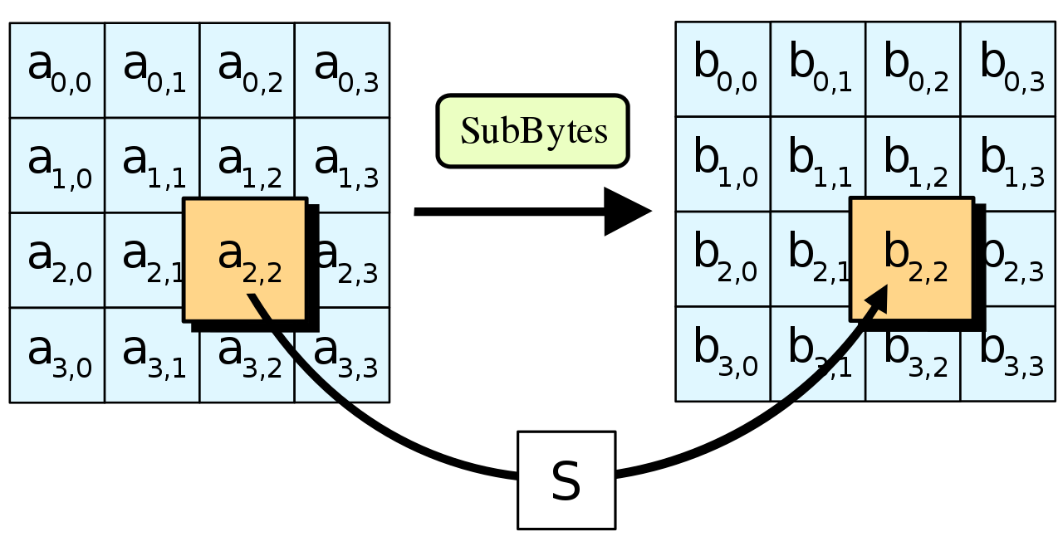
SubBytes
A non-linear substitution step where each byte is replaced with another according to a lookup table.
SubBytes

Slide 11
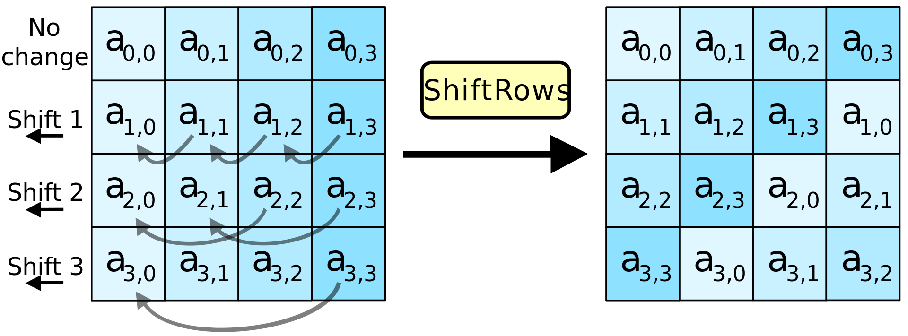
ShiftRows
A transposition step where the last three rows of the state are shifted cyclically a certain number of steps.

Slide 12
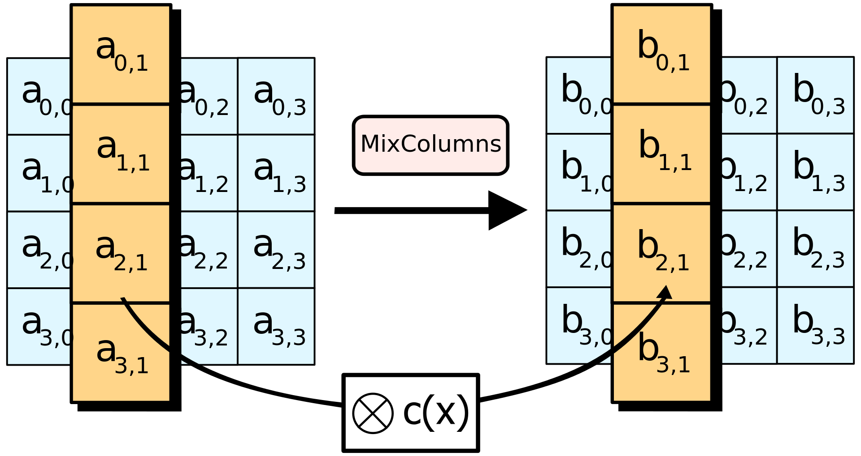
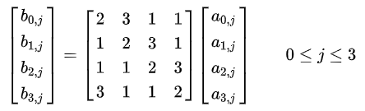
MixColumns (except for the last round)
A linear mixing operation which operates on the columns of the state, combining the four bytes in each column.
MixColumns

Slide 13
Workflow
Architecture
Flow
Modules
Implementation
Per module implementation
Specific module simulation.
Integration
Decode stage.
Write-Back stage.
Simulation
Full AES simulation.
Comparison to C implementation.
Extensions
Accessories
Automations
Introduction
AES algorithm
Workflow
Simulations
Results
Methodology
Conclusions

Slide 14
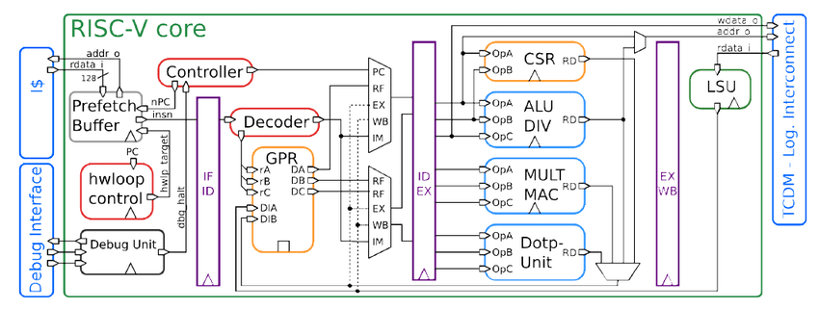
Base architecture - selected solution
128-bit data
AES register file
128-bit data
AES engine
AES WB
32-bit
128-bit key
128-bit ciphered
32-bit

Slide 15
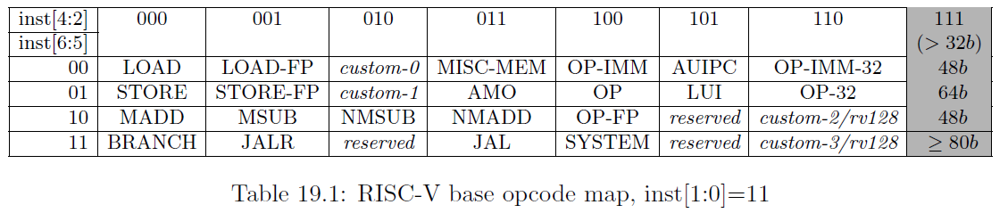
Commands structure
0x0
0x0
0x[0-31]
0x[0-4]
0x[0-3]
0x3b
Opcode
AES register (key or data)
AES function
RISCV register
Not in use

Slide 16
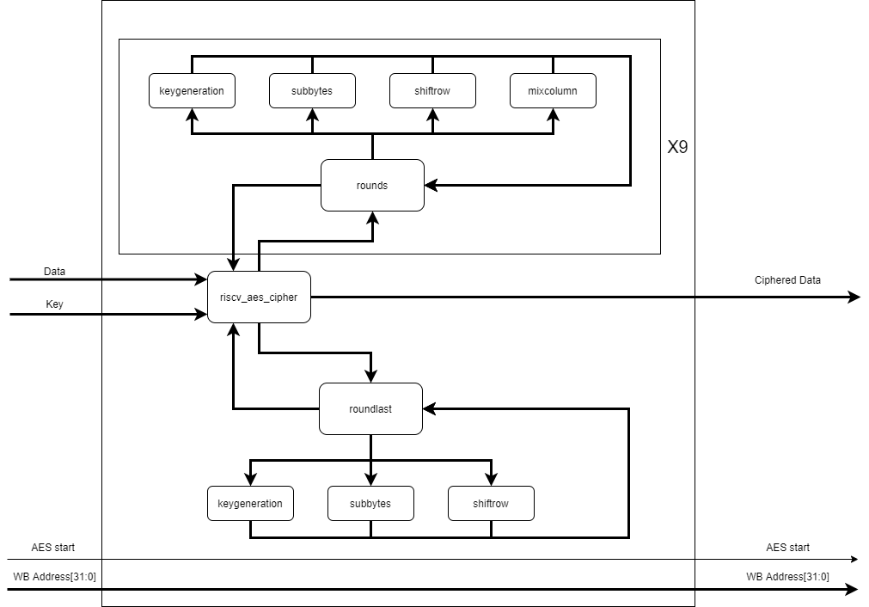
AES Engine Architecture

Slide 17
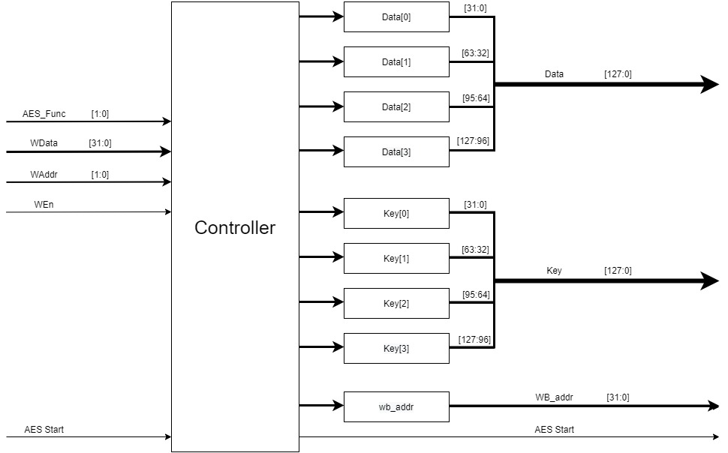
AES Register File Architecture

Slide 18
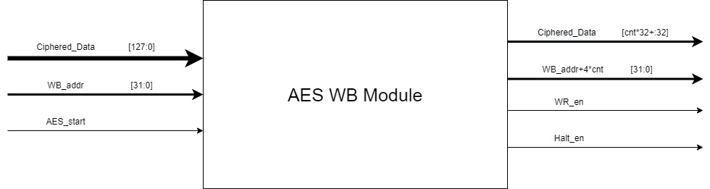
AES Write Back Architecture

Slide 19
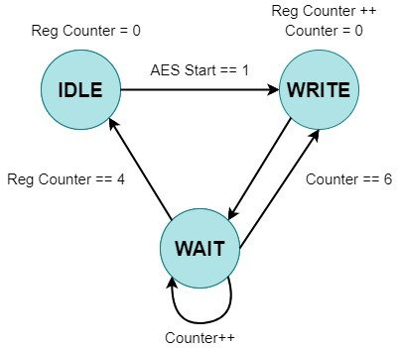
AES Write Back FSM

Slide 20
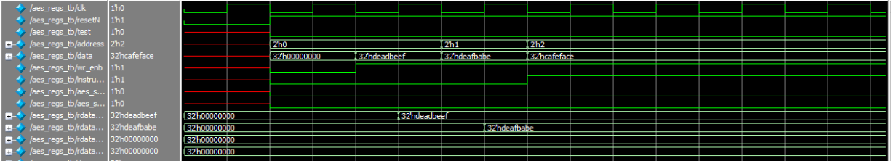

Simulations
Register file simulation
Introduction
AES algorithm
Workflow
Simulations
Results
Methodology
Conclusions

Slide 21
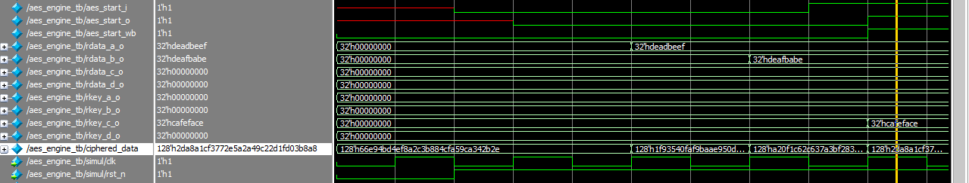
AES engine simulation

Slide 22
AES WB simulation

Slide 23
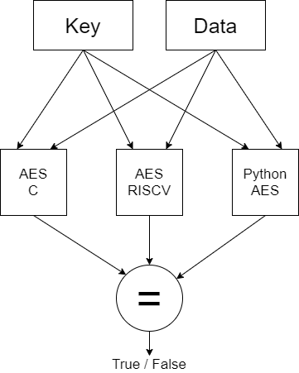
Conformity check

Slide 24
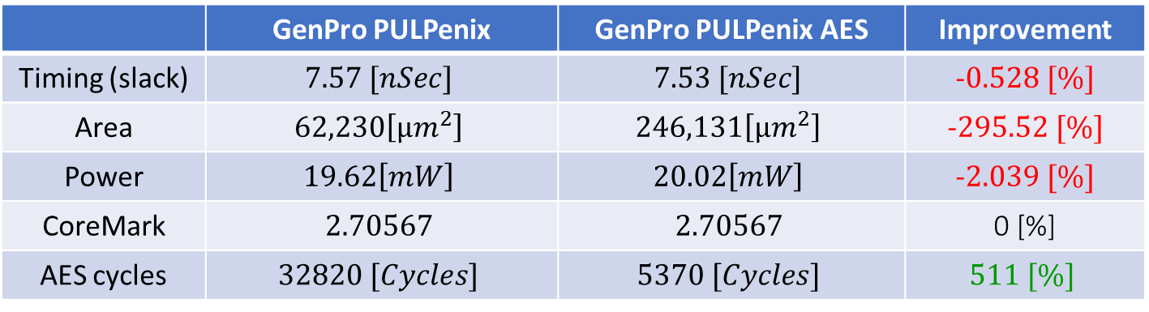
Results
 | GenPro PULPenix | GenPro PULPenix AES | Improvement
Timing (slack) | $$7.57 [nSec]$$ | $$7.53 [nSec]$$ | -$0.528 [\%]$
Area | $$62,230\left[μm^{2}\right]$$ | $$246,131\left[μm^{2}\right]$$ | -$295.52 [\%]$
Power | $$19.62\left[mW\right]$$ | $$20.02\left[mW\right]$$ | -$2.039 [\%]$
CoreMark | $$2.70567$$ | $$2.70567$$ | 0 [%]
AES cycles | $$32820 [Cycles]$$ | $$5370 [Cycles]$$ | $$511 [\%]$$
Introduction
AES algorithm
Workflow
Simulations
Results
Methodology
Conclusions

Slide 25
Methodology
Synthesis
Normally synthesis is done using dc_shell’s GUI.
We decided we want to make the synthesis step automatic, in one command.
The solution is synthesis script:
Allows us to run synthesis in one command.
No need of dc_shell’s GUI.
Adding file to the design can be done by adding the file name to the script.
Introduction
AES algorithm
Workflow
Simulations
Methodology
Methodology
Conclusions

Slide 26
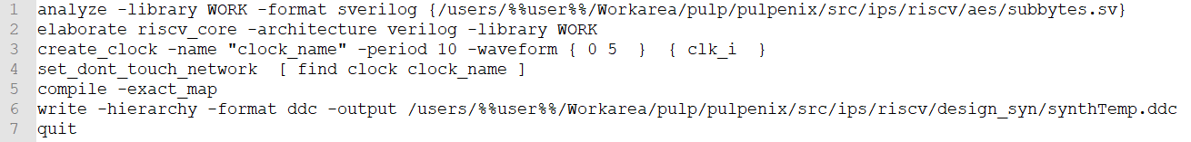
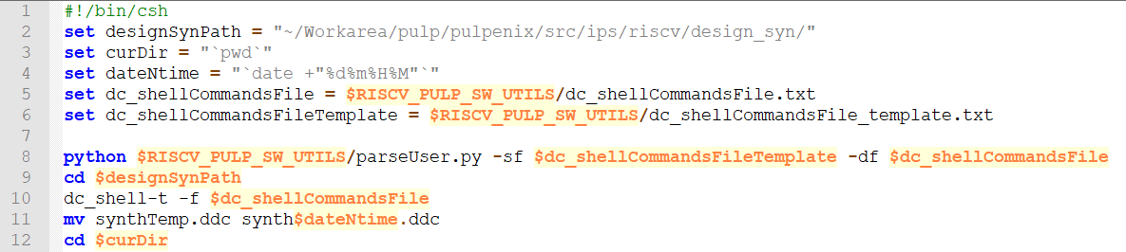
Synthesis script

Slide 27

Compilation
GCC doesn't support the new AES commands
Possible solutions:
Write hardcoded hex commands (using asm .word).
Update GNU’s compiler.
Create external pre-compiler.

Slide 28
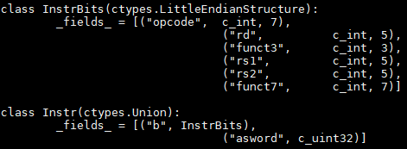
Python’s ctypes

Slide 29
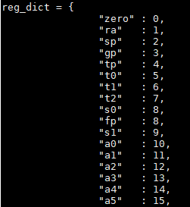
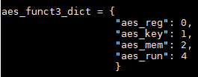
Dictionaries

Slide 30
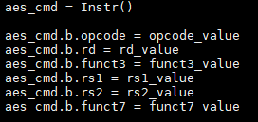

Instruction assignment

Slide 31
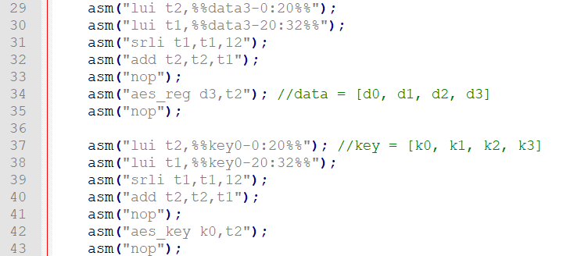
AES test

Slide 32
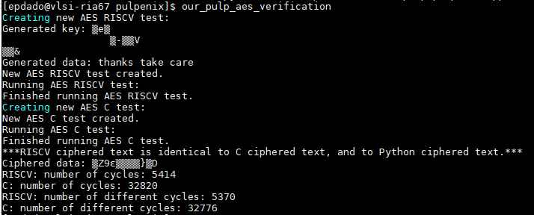
AES verification test

Slide 33
Conclusions
Successfully integrate AES engine inside RISCV core
Minimal effect on power and timing performance
Significant effect on area
Create user friendly AES commands support
Add compiling scripts that run before GNU’s compiler
Create AES verification script
Improve existing simulation scripts
Improve GenPro setup script
Add new simulation options
Add synthesis script
No need to open dc_shell to synthesize the project
Introduction
AES algorithm
Workflow
Simulations
Results
Methodology
Conclusions

Slide 34

Questions?

Slide 35
Thank you for your time!

